Slide 1
The effect of immunization factors on Life Expectancy
A comparison between developed and developing countries
Raquel Noblejas Sampedro
Ana Cecilia Sarabia Flores
Narges Pourshian
Rodolfo Sanchez Mora
Pratik Pachpute

Slide 2
INTRODUCTION
Many studies have focused on exploring the factors that affect life expectancy in different nations. These studies utilize different variables to research and evaluate the association across factors, such as income, demographics, and mortality.
There are not many studies that compare the relevance and effect of immunization factors on life expectancy between developed and developing countries.
The results of this experiment could be of interest not only to governments in terms of immunization funding and prioritization of their healthcare systems, but also to private pharmaceutical companies and non-profit humanitarian organizations in their decision making for vaccine development and collaboration programs.
Additionally, this could support other research in topics such as immunization factors, healthcare, economic development, and policy.

Slide 3
PROBLEM STATEMENT
The questions this study aims to answer are the following:
What is the effect of immunization factors on life expectancy?
Do immunization factors have different levels of association and influence on life expectancy depending on the country’s developing status?
The project focuses on five immunization factors and their effect on life expectancy for several countries, which are categorized as either developed or developing, to study the differences of such effects in conjunction with other relevant variables.
The immunization factors considered in this project are Measles, Hepatitis B, Polio, Diphtheria, and HIV/AIDS.

Slide 4
Related work on Effect of Immunization Factors on Life Expectancy
Life expectancy is an important measure that allows comparing different metrics across generations, analyzing trends, and prioritizing public and economic policy.
There are multiple studies that focus on the determinants of life expectancy. However, there are very few that analyze immunization factors across developed and developing countries.
In the paper “Impacts from Economic Development and Environmental Factors on Life Expectancy: A Comparative Study Based on Data from Both Developed and Developing Countries from 2004 to 2016.”, Chen, Ma, Hu, Hua, Wang and Guo (2021) argue that life expectancy is impacted by environmental factors and economic development.
The paper divides the observations depending on the development status of the countries to show the impact of different variables on life expectancy through an Ordinary Least Square multiple regression model.

Slide 5
Related work on Effect of Immunization Factors on Life Expectancy
The authors claim that the notorious increases in healthcare spending and economic conditions since the beginning of the 20th century have increased longevity
Other studies suggest that the observed growth in life expectancy in developed countries, such as the United States, was associated with the higher income level compared to other nations. However, the authors dismiss this theory by arguing that this linkage between income levels and life expectancy varies greatly across regions (Chen et al., 2021).
The paper considers decreases in income inequality to have a greater impact on life expectancy increases than plain income growth, resulting from a more spread distribution of resources that improves living conditions throughout the population and pushes the indicator up

Slide 6
Related work on Effect of Immunization Factors on Life Expectancy
Earlier research considered a multivariate linear regression model, as previous datasets only included information for one year, did not have immunization factors, and excluded some of the countries that this latest version incorporates.
Even with these data limitations, the experiments proved that there is a relationship between life expectancy and the selected variables.
This project follows the methodology used Chen et al. (2021) by dividing the data based on development status of each country, and then regressing the variables to analyze the association with life expectancy.
The study’s approach is different as the variables of interest are immunization factors, rather than economic and environmental elements.

Slide 7
Data description
The data used in this project was collected from the Global Health Observatory data repository under the World Health Organization, and its corresponding economic data was collected from the United Nations. The data was accessed through Kaggle data and code repository.
This dataset includes information about life expectancy, health factors, and social and economic variables. It is composed of 22 variables, 18 numeric and 4 nonnumeric.
The first variable was excluded of the analysis since it served as a unique identifier for each observation. The variable Country lists the names of the 193 countries for which data was collected. The variable Year displays the specific year in which the observation was included in the dataset, and the variable Status consisted of the development category for each country with two options, “Developed” or “Developing”.

Slide 8
Exploratory Data Analysis
A summary statistic of the remaining 18 numeric variables used in this study are shown in Table 1.
An alternative use of this data is country-specific analysis of life expectancy determinants, since the data is structured on a per country and year basis

Slide 9
Technical approach
Before any comparison and analysis could be made, it was necessary to examine the data in detail.
The dataset was revised for accuracy, where the only transformation executed was defining the variable Status as categorical for proper analysis. No data inconsistencies were found.
Missing data points were spotted throughout different rows and variables, representing a larger-than-expected percentage of NAs.
At the column level, the variables with higher percentage of missing data were Population (22.2%), Hepatitis B (18.8%), and GDP (15.3%). Most of the missing data was associated with not well-known countries.
Assuming the absent data was missing completely at random (MCAR), the multiple imputation method was used to fill in the dataset. This technique was applied to the rows with less than 50% of missing values.

Slide 10
Technical approach
Because of the nature of the data, which compares multiple measures across countries with different income and development levels, it was expected to find several outliers.
These outliers were identified using three methods: Leverage, Cook’s, and Mahalanobis distance. A simple linear regression with all the variables of the dataset was run to calculate these metric, using a K value of 19. Table 2 below summarizes the results.
Lastly, all measures of outliers were added, showing 132 common outliers in two conditions and 74 in three conditions, for a total of 133 outliers identified in the dataset, which were then excluded from the data used to perform further analysis.

Slide 11
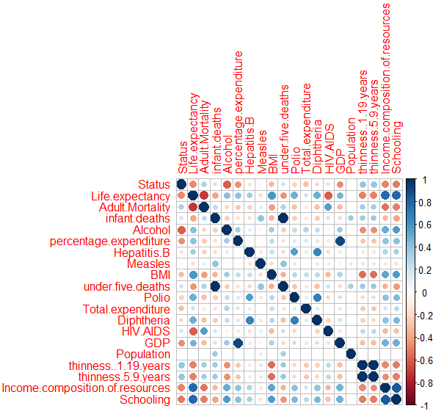
Technical approach
In terms of Additivity, the results of the bivariate correlation show that there are high correlations between variables that are in nature associated with one another.
Infant Deaths and Under Five Deaths with correlation coefficients of 0.95. Under Five Deaths was excluded as the variable Infant Deaths should cover all the data.
Thinness 5-9 years and Thinness 1-19 years also with a correlation coefficient of 0.95. Thinness 5-9 years was drooped since any values in that variable should also be included in Thinness 1-19 years.
GDP and Percentage Expenditure on Health, presented a correlation of 0.9. GDP was dropped.
Schooling and Income Composition of Resources displayed a coefficient of 0.8. Income composition of resources was dropped.

Slide 12
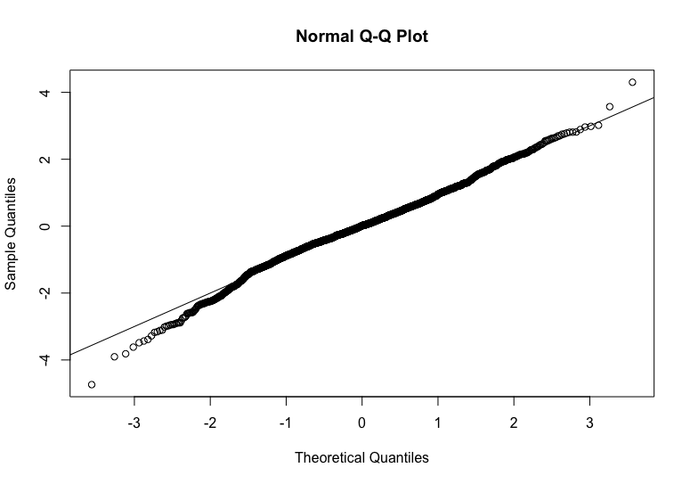
Technical approach
Linearity tests show that the dataset is linear, as denoted by the Normal Q-Q plot which displays the standardized results of the regression as points that, ideally, are on or very close to the benchmark line. This is the case for the data.

Slide 13
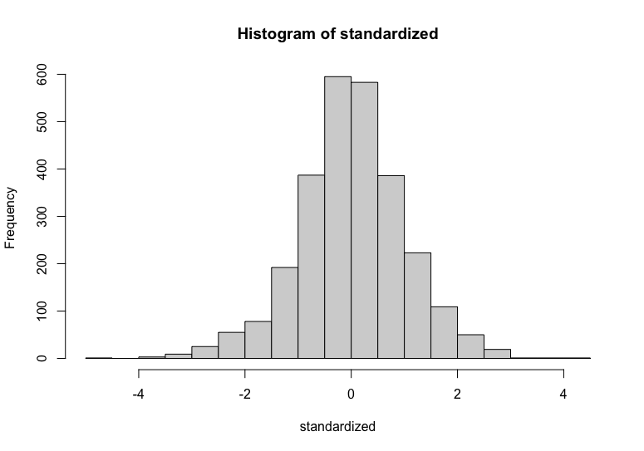
Technical approach
Normality was tested by plotting a histogram of the standardized residuals, with most of the data close to the center and spread between -2 and 2. Some of the non-significant predictors such Measles and Population are skewed, but this is acceptable as these are not highly influencing the model. Hence, the assumption of Normality is met

Slide 14
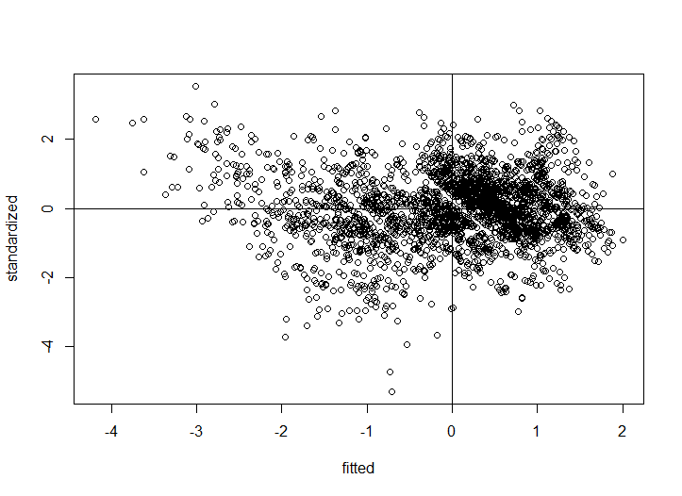
Technical approach
Lastly, the assumptions of Homogeneity and Homoscedasticity were also tested by plotting the fitted values and standardized results.
Wider spread at the left of the vertical guideline, with values reaching -4.
Greater concentration of points above and to the right of the zero guidelines.
The majority of the points are concentrated around the -1.5 and 1.5 marks.
These results are acceptable and meet the assumptions.

Slide 15
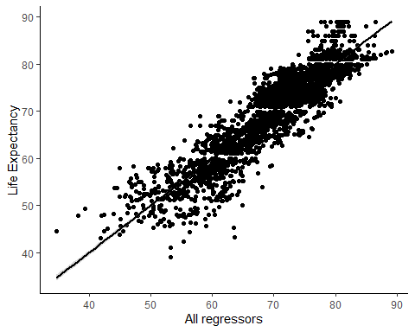
TEST AND EVALUATION
Once the dataset was cleaned and tested, a preliminary regression to observe the association between the variables was performed
Presented a relatively high R-Squared, 0.8258, which indicates that the independent variables included can explain the changes in Life Expectancy with an accuracy of 82.58%.
The model is significant with a p-value of 0.000, a high F-statistic of 915, and 2703 degrees of freedom.

Slide 16
TEST AND EVALUATION
Table 3 below summarizes the results of the preliminary regression with clean data.
Schooling was the strongest positive predictor and the most significant too with a very high b value of 1.154, followed by BMI, Diphtheria, Polio, and Percentage expenditure.
Polio and Diphtheria showed up as Positive predictors in the overall model which was an interesting find.
Status turns out to be the strongest negative predictor, with HIV-AIDS as the second most significant negative, followed by Thinness1 to 19, Adult mortality and Infant deaths.

Slide 17
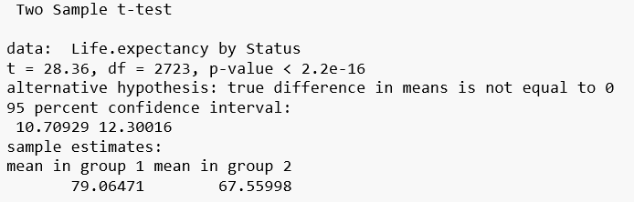
TEST AND EVALUATION
The independent t-test conducted on Life Expectancy based on the Status variable presented statistically significant results with a p-value of < 2.2e-16, and a t value of 28.36.
The test also showed the mean values of each group, 79.06471 and 67.55998 for Developed and Developing, respectively. Therefore, we can reject the Null Hypothesis of equal means.

Slide 18
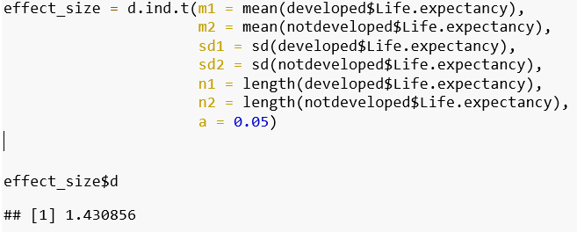
TEST AND EVALUATION
Once this difference was statistically proved, the effect size was also calculated for this sample.
Using the means, standard deviations, number of observations for each group, the effect size resulted in 1.430856.

Slide 19
TEST AND EVALUATION
Table 4 shows the regression results of the developed group.
Adult Mortality, Alcohol, BMI, Total expenditure, Thinness 1 to 19 and Schooling significant predictors
Infant Deaths, Hepatitis B, Measles, Diphtheria, HIV and Population appear to be nonsignificant.
Schooling was the only significant positive predictor with a b value of 0.2954 and a p-value of 0.000. Percentage expenditure also showed a low p-value at 0.000, accompanied by an also very low coefficient value.
Thinness 1 to 19 years, Alcohol, and Adult Mortality were most significant negative predictors, followed by Total expenditure and BMI, which resulted to be a negative predictor, while infectious disease variables were nonsignificant.

Slide 20
TEST AND EVALUATION
Table 5 displays the regression results for the developing group
Schooling, BMI, Diphtheria, Polio, and Percentage Expenditure showed as very significant and positive predictors
HIV AIDS was the most significant negative predictor with a p-value of 0.000 and an estimate of -0.66, followed by the only other negative significant predictor, Adult Mortality with a p-value of 0.000.
Thinness 1 to 19 years, Population, Total expenditure, Measles, Hepatitis B, Alcohol, and Infant deaths showed nonsignificant results for developing countries, with p-values greater than 0.05.

Slide 21
TEST AND EVALUATION
Tables 6 and 7 present the results of the developed and developing models with only those variables that resulted significant from the previous regressions, whose values are shown in tables 4 and 5.

Slide 22
TEST AND EVALUATION
Some variables that are good predictors of Life Expectancy in both developed and developing models.
Adult Mortality, with negative coefficients and p-values of 0 in both models
Percent Expenditure with relatively low positive impact and low p-values
BMI with negative impact and p-value of 0.04 for developed, and positive impact with p-value of 0 for developing
Schooling, with low p-values in both models, and greater association in the developing model compared to the developed.

Slide 23
TEST AND EVALUATION
As suspected, the variables Polio, Diphtheria, and HIV AIDS are statistically significant predicting Life Expectancy in developing countries, but not in developed ones.
It is important to mention that only three of the five variables considered as immunization factors have resulted significant in the expected group, and, most importantly, the remaining two variables (Measles and Hepatitis B) are not significant for either group.
These results prove that the selected immunization factors have different significance and association with Life Expectancy depending on the development status of a country.

Slide 24
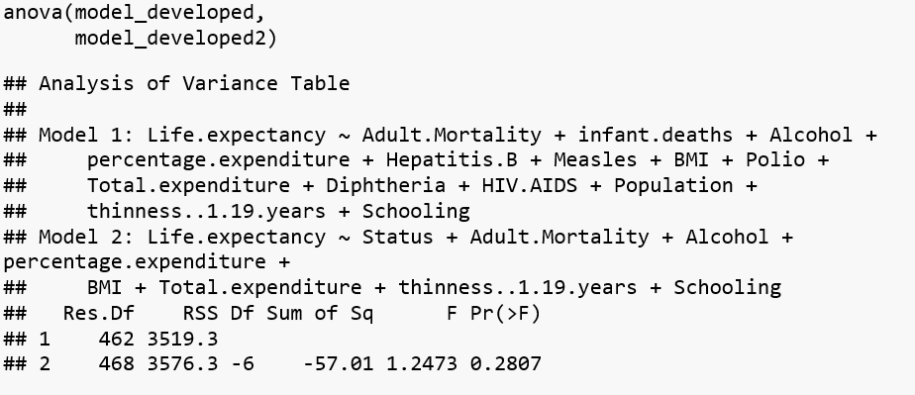
TEST AND EVALUATION
ANOVA tests were conducted for each pair of models to confirm that the excluded nonsignificant values had no effect on their corresponding models.
For the developed pair of models, the resulting p-value was nonsignificant at 0.2807, failing to reject the Null Hypothesis that the coefficients of the variables dropped are equal to 0.

Slide 25
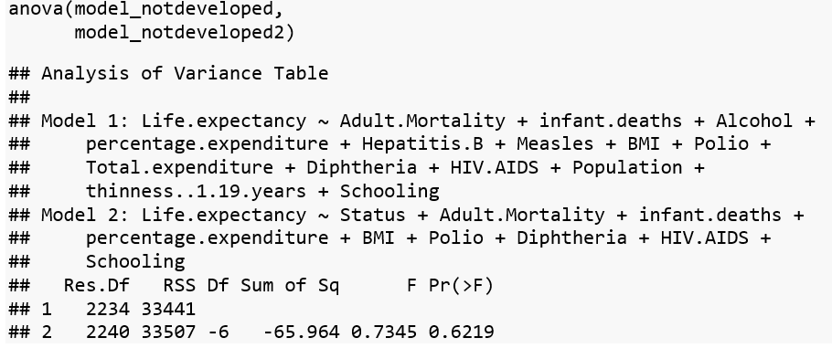
TEST AND EVALUATION
For the developing pair of models, the p-value was also nonsignificant at 0.6219, therefore failing to reject the Null Hypothesis. Both models appear to be appropriate for the type of analysis that was intended.

Slide 26
TEST AND EVALUATION
There were some challenges when working and analyzing the data.
The biggest task to overcome was properly dealing with missing values. As mentioned at the beginning of the paper, there was a higher-than-expected percentage of missing values at both the column and row levels.
Removing these NA values was not ideal since the absent data could impact the model results. The percent of data to be replaced through the multiple imputation method had to be increased substantially to reach the expected regressions results.
In addition, working with fewer years that included a lower percentage of missing values was also explored, but the results of the model differ as the discrepancies in immunization factors between developed and developing countries reduced over the years

Slide 27
CONCLUSION AND RECOMMENDATIONS
Conclusion: The purpose of this project was to explore the differences in the determinants of Life Expectancy based on the development status of countries, with a special focus on immunization factors. After cleaning and accommodating the dataset used, and through a series of multivariate regression analysis, it was found that there are substantial differences in the determinants of Life Expectancy for developed and developing countries, including immunization factors such as Polio, Diphtheria, and HIV AIDS. Though not all the considered immunization factors presented such results, it was clear that the development level of a country influences the factors affecting Life Expectancy.
It is recommended to extend the type and number of elements included the models, considering additional and more granular economic, social and health variables.
Examples include GDP growth, political preferences, and percent of aging population.
This will provide more detail to the model specifications and to the concreate actions to be adopted as a result.

